Slide 1
Differential white blood cell count

Slide 2
The white blood cells may be classified into
Granulocyte: cells having granules in their cytoplasm.
1. Neutrophils
2. Eosinophils
3. Basophils
A granulocyte: cells in which granules are absent.
1. Lymphocytes
2. Monocytes

Slide 3
Differential white blood cell count
(Differential leukocyte count)
determines the number of each type of white blood cell, present in the blood.
It can expressed as a percentage (relative numbers of each type of WBC in relationship to the total WBC).

Slide 4
Blood smear
blood smear is one of the most frequently requested tests in the hematology laboratory.
Blood smear must be prepared correctly and examined in such a way as to provide the physician with an accurate interpretation.

Slide 5
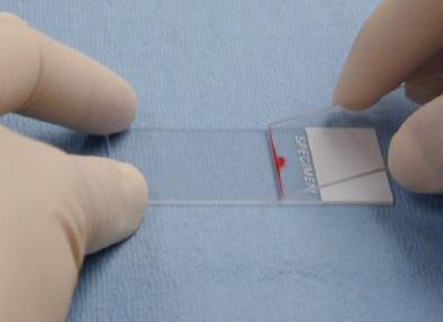
Procedure
Place a drop of blood from the finger
about 2 mm in diameter in the central line
of a slide about 1-2 cm from one end.
2.The spreader is placed at angle of 45
degrees to the slide and then moved
back to make contact with the drop.

Slide 6
The drop should spread out quickly along the line of contact of the spreader with the slide.
The drop should be of such size that the film is 3-4 cm in length.

Slide 7
The film should be dried rapidly. A good blood film preparation will be thick at the drop end and thin film at the opposite end.
The thickness of the spread when pulling the smear is determined by the:
Angle of the spreader slide.
Size of the blood drop.
Speed of spreading.

Slide 8
Fixing of blood films
Before staining, the blood films need to be fixed with acetone free methyl alcohol for 0.5 to 2 minutes in order to prevent hemolysis when they come in contact with water when water has to be added subsequently. Alcohol denature the proteins and hardness the cell contents.

Slide 9
Stain preparation and staining
Leishmans stain
Composition
Powdered Leishmans stain 0.15 mg
Methyl alcohol 133 ml
Method of staining
Pour few drops (about 8) on the slide, Wait for two minutes.
Add double the amount (16 drops) of buffered water. Mix by rocking and wait for 7-10 minutes.
The stain is flooded off with distilled water and this should be complete in 2-3 second, and allow it to dry.

Slide 10
Giemsa stain
Giemsa powder 0.3 mg
Glycerin 25 ml
Methyl alcohol 25ml
This makes stock solution and before use it has to be diluted by adding 1 ml (stain) to 9 ml buffered water.
Method of staining
The blood is fixed with methyl alcohol for 2 minutes.
Pour Giemsa stain diluted 1:9 with buffer over the smear for 8-10 minutes.
Wash off with buffer and dry.

Slide 11
Examination of a blood film
There are several necessary step in the examination of a peripheral blood smear:
Under the low- power (10X), determine the overall staining quality of the blood smear.
Determine if there is a good distribution of cells on the smear.
Find an optimal area for the detailed examination and enumeration of cells.

Slide 12
The count
The dry and stained film is examined without a coverslip under oil immersion objective. For differential leucocyte counts choose an area where the morphology of the cells is clearly visible. Do differential count by moving the slide in area including the central and peripheral of the smear. A total of 100 cells should be counted in which every white cell seen must be recorded in a table under the following heading: Neutrophil, Basophil, Eosinophil, Monocyte and Lymphocyte. Then find the percentage of each type.

Slide 13
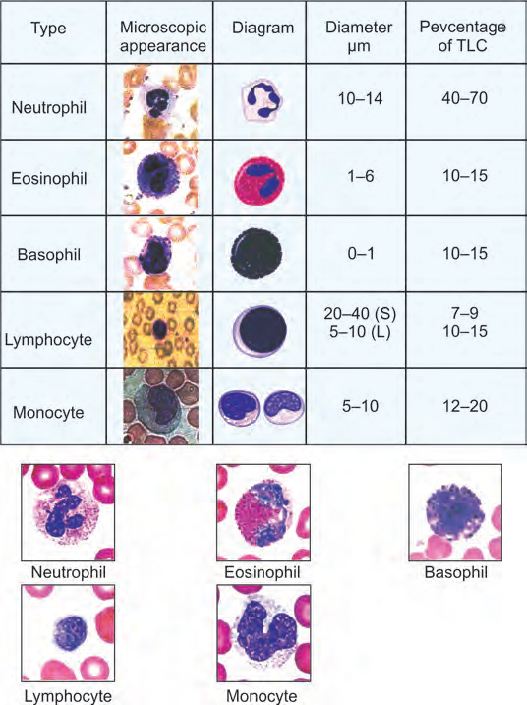
Normal Results
Neutrophils: 40% to 60%
Lymphocytes: 20% to 40%
Monocyte: 2% to 8%
Eosinophils: 1% to 4%
Basophils: 0.5 to 1%
Band (young neutrophil): 0% to 3%

Slide 14
What abnormal results Mean
Any infection or acute stress increases your number of white blood cells. High white blood cell counts may be due to inflammation, an immune response, or blood diseases such as leukemia.
It is important to realize that an abnormal increase in one type of white blood cell can cause a decrease in the percentage of other types of white blood cell.

Slide 15
An increase percentage of neutrophils may be due to:
Acute infection
Acute stress
Gout
Myelocytic leukemia
Rheumatic fever
Rheumatoid arthritis
Thyroiditis
Trauma

Slide 16
A decreased percentage of neutrophils may be due to:
Aplastic anemia
Chemotherapy
Influenza
Radiation therapy or exposure
Viral infection
Widespread Severe bacterial infection

Slide 17
An increase percentage of lymphocytes may be due to:
Chronic bacterial infection
Infection hepatitis
Infection mononucleosis
Lymphocytic leukemia
Multiple myeloma
Viral infection (such as mumps or measles)

Slide 18
A decreased percentage of lymphocytes may be due to:
Chemotherapy
HIV infection
Leukemia
Radiation therapy or exposure
Sepsis
Steroid use

Slide 19
An increase percentage of monocytes may be due to:
Chronic inflammatory disease
Leukemia
Parasitic infection
Tuberculosis
Viral infection (for example, infectious mononucleosis, mumps, measles)

Slide 20
An increase percentage of eosinophils may be due to:
Addison ,s disease
Allergic reaction
Cancer
Collagen vascular disease
Hypereosinophilic syndromes
Parasite infection

Slide 21
An increase percentage of basophils may be due to:
After splenectomy
Allergic reaction
Collagen vascular disease
Myeloproliferative disease
Varicella infection
An decrease percentage of basophils may be due to:
Acute infection
Cancer
Severe injury

